Slide 1
USAID’S SUCCESSFUL AIMAK 2 PROJECT
GOALS AND EXPECTED OUTCOMES

Slide 2
PROJECT GOAL
Improve the well-being of citizens through strengthening the effectiveness and accountability of local governments in service delivery
Water supply ● Waste collection and removal ● Recreation ● Public areas management

Slide 3
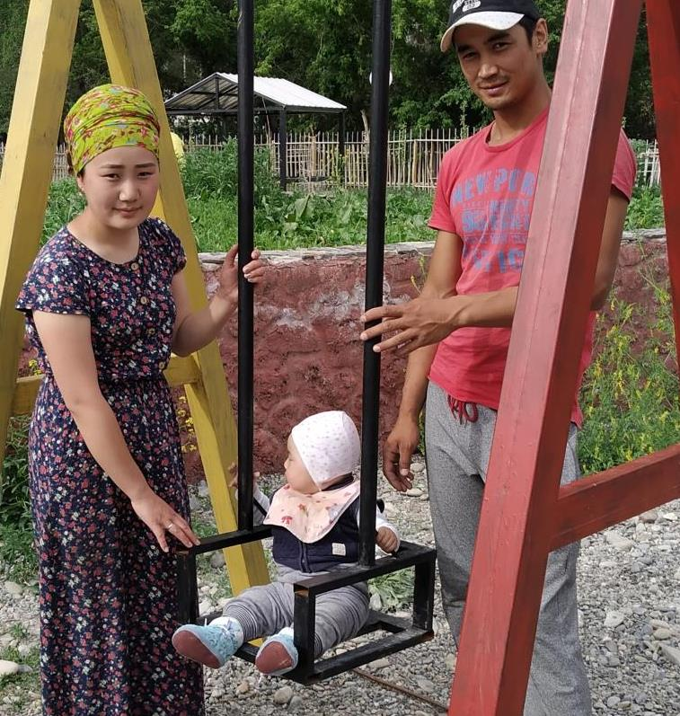
PROJECT INFORMATION
DURATION:
Sep 2021 – Sep 2025
BUDGET:
$ 4.9 million
ACTIVITY LOCATION:
Jalal-Abad, Issyk-Kul, Naryn and Osh oblasts
IMPLEMENTATION PARTNER:
Development Policy Institute (DPI), Kyrgyz Republic

Slide 4
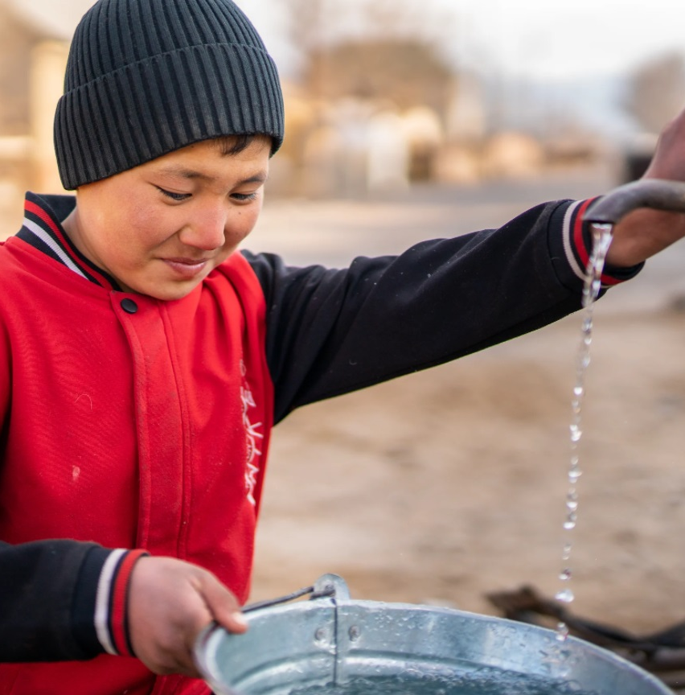
IMPROVED LOCAL SERVICES
Improved management practices = effective delivery of local services
Financial sustainability of local services through:
Introduction of appropriate tariffs
Increasing income
Partnerships with local entrepreneurs
Using IT solutions

Slide 5
LSG ACCOUNTABILITY & CITIZEN ENGAGEMENT
Citizen engagement in service quality assessment at the local level
Active citizen participation in formation of local budgets
Outcome: increased level of public trust in the LSG bodies

Slide 6
SHARING EXPERIENCE
Exchanging best practices in service delivery at national and regional events
LSGs Best Practices Portal by the Academy of Local Governance of Central Asia
Joint search for effective solutions and their implementation

Slide 7
PROMOTION OF LSG INTERESTS
Legislative initiatives for local self-governance development
Participation of LSG bodies in discussions
Support to the Union of LSGs

Slide 8
USAID CONTACT:
Timurlan Baiserkeev
tbaiserkeev@usaid.gov
USAID / Оливье Леблан
DPI CONTACT:
Sabina Gradwal
sgradwal@dpi.kg

